Slide 1


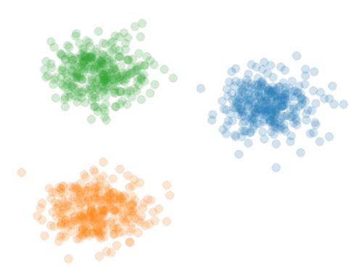
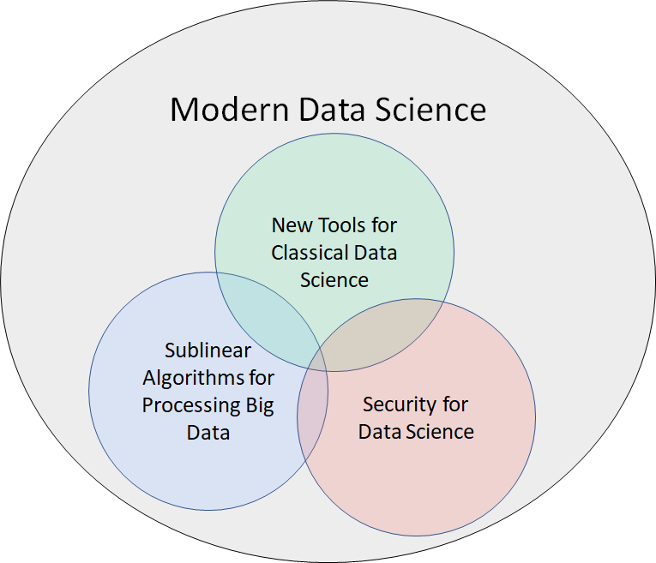

Theoretical Foundations of Modern Data Science
Samson Zhou

Slide 2



Background
Post-doc at UC Berkeley / Rice
Previous: Post-doc at Carnegie Mellon
PhD in Computer Science from Purdue
Dual Bachelors in Math, Computer Science from MIT
Research areas: Data science, sublinear algorithms, security and privacy
Notes:
I’m currently a postdoc at UC Berkeley and Rice. My research areas fall under the foundations of data science, sublinear algorithms, and security and privacy, but the central theme is introducing provable guarantees and efficient implementations for big data algorithms subject to evolving modern demands. Specifically, my goal is to have substantial real-world impact through research, teaching, and service, and so I’m looking for a platform that will enable and empower me to have such impact, which is why I’m so excited for the opportunity to apply to academia and industry research positions.

Slide 3

Data Science
Notes:
Enough about me, let’s talk about data science. Sources of big data are now universally present, across social media, financial markets, Internet of things, scientific data, so on and so forth, and thus understanding how to effectively and efficiently summarize the data is a crucial step toward both understanding past events as well as predicting future events.

Slide 5





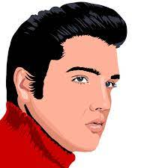


Slide 6
1 1 0 1 0 1
0

Slide 7
1 1 0 1 0 1
0 1 1 1 0 0
0
1
Notes:
Example: regression

Slide 8
1 1 0 1 0 1
0 1 1 1 0 0
0 1 0 1 1 1
0 1 1 0 1 0
1 0 1 1 1 1
0 1 1 1 0 1
0 0 1 0 1 1
0
1
1
0
0
1
0
Notes:
Example: regression

Slide 9
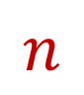
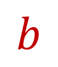
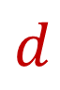

$$A$$
$$b$$
1 1 0 1 0 1
0 1 1 1 0 0
0 1 0 1 1 1
0 1 1 0 1 0
1 0 1 1 1 1
0 1 1 1 0 1
0 0 1 0 1 1
0
1
1
0
0
1
0
$$n$$
$$d$$
Notes:
Example: regression

Slide 10
$$A$$
$$b$$
1 1 0 1 0 1
0 1 1 1 0 0
0 1 0 1 1 1
0 1 1 0 1 0
1 0 1 1 1 1
0 1 1 1 0 1
0 0 1 0 1 1
0
1
1
0
0
1
0
$$n$$
$$d$$
Notes:
Example: regression

Slide 11
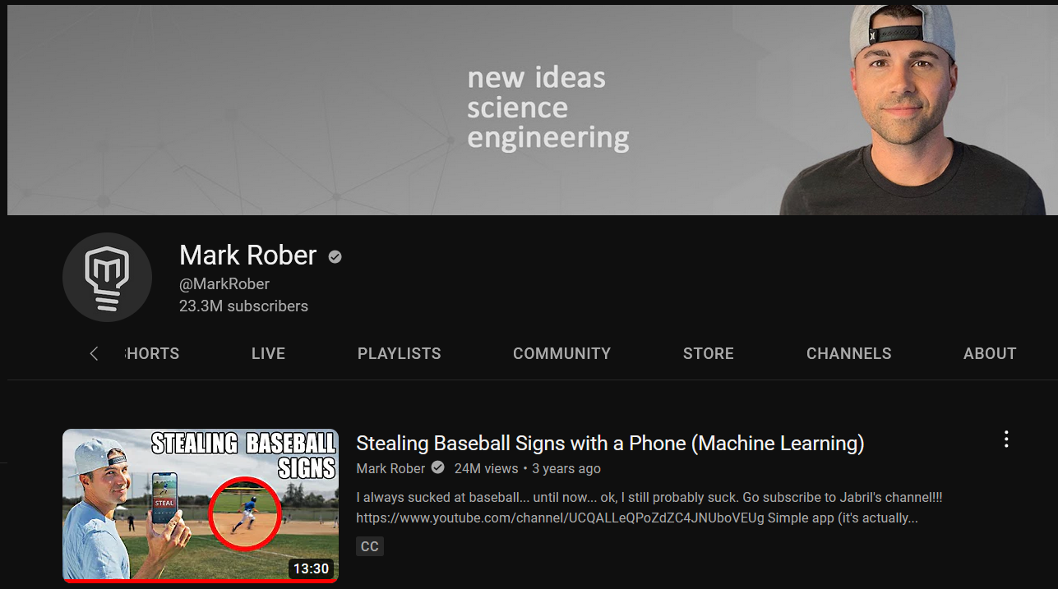

Slide 12

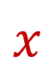
$$A$$
$$b$$
1 1 0 1 0 1
0 1 1 1 0 0
0 1 0 1 1 1
0 1 1 0 1 0
1 0 1 1 1 1
0 1 1 1 0 1
0 0 1 0 1 1
0
1
1
0
0
1
0
$$x$$
$$n$$
$$≈$$
$$d$$
Notes:
Example: regression

Slide 13
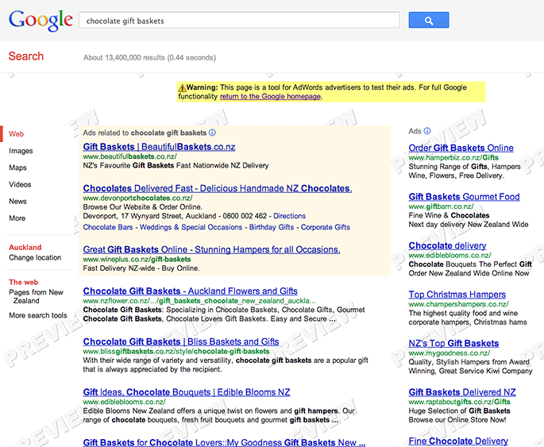

Slide 14
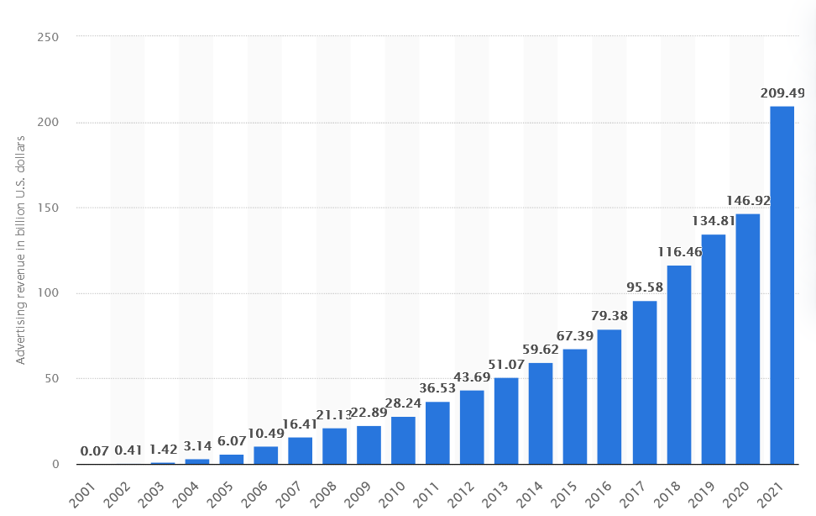

Google Ad Revenue (2001-2021, billion USD)

Slide 15
Modern Data Science
New Tools for Classical Data Science
Sublinear Algorithms for Processing Big Data
Security for Data Science

Slide 16
Evolving Demands
Sublinear-time or sublinear-space algorithms
Incorporation of advice
Security for data science
Robustness to noise or adversarial input
Ability to handle time-sensitive data
Notes:
However, as the field of big data algorithms matures, we have realized that often implementing an algorithm to simply perform analysis is not enough; we might also require specific properties or functionality from the algorithm, such as sublinear-time or sublinear-space, incorporation of advice, security and privacy, robustness to noise or adversarial input, or the ability to handle time-sensitive data. These are crucial qualities that I’ve integrated into my research on algorithmic design and so throughout this talk as I summarize some of my broader work in each of the Venn diagram categories, I’ll also interleave discussion of these modern demands.

Slide 17
New Tools for Classical Data Science
New Tools for Classical Data Science
Notes:
Green circle

Slide 18
Evolving Demands
Sublinear-time or sublinear-space algorithms
Incorporation of advice
Security for data science
Robustness to noise or adversarial input
Ability to handle time-sensitive data

Slide 19
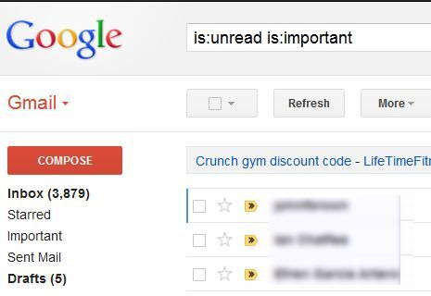

330 billion daily e-mails
3 billion monthly active users
8.5 billion daily Google searches

Slide 20

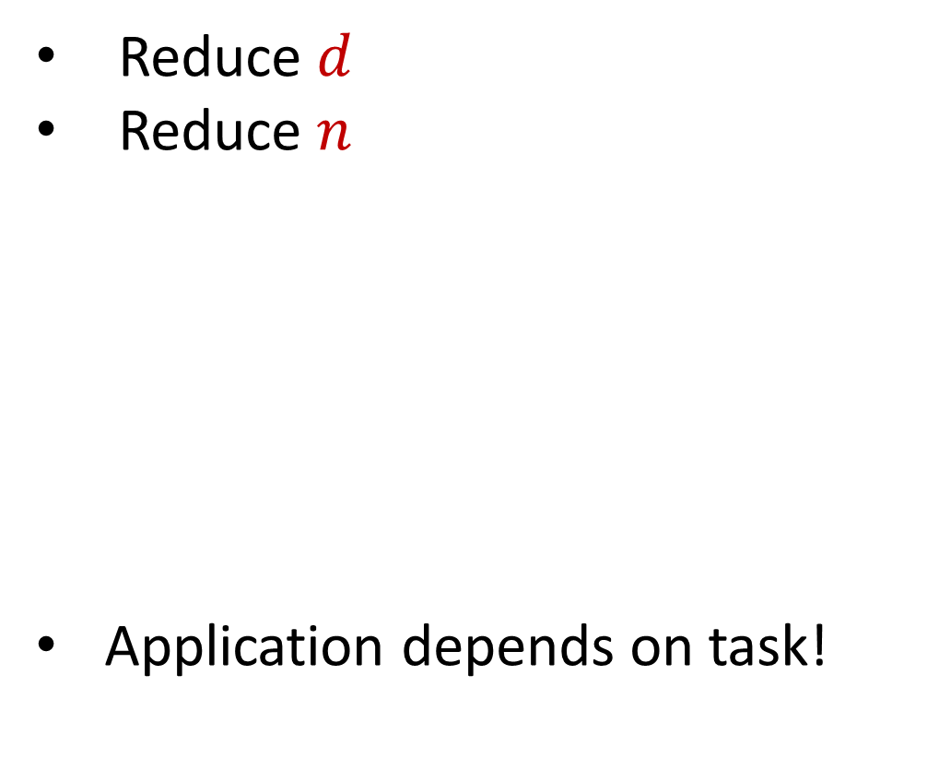
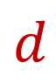
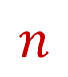
Dimensionality Reduction
Reduce $d$
Reduce $n$
Application depends on task!
Sampling, Sketching, Johnson-Lindenstrauss, IsoMap
$$n$$
$$A$$
Sampling, Sketching,
Coresets
$$d$$
Notes:
n = observations, d = features

Slide 21
New Dimensionality Reduction Results
Dimensionality reduction for Wasserstein barycenter [ISZ21]
Sketching for valuation functions, e.g., additive, submodular, Lipschitz [YZ19]
Kernel density estimation on kernel matrices [BKISZ22]
Notes:
Too fast

Slide 22
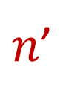


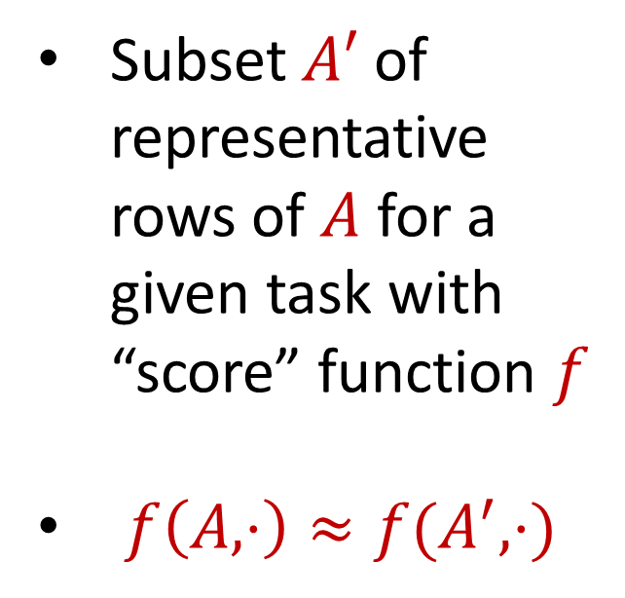
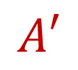
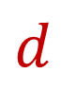
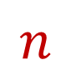
Coreset
Subset $A′$ of representative rows of $A$ for a given task with “score” function $f$
$f\left(A,⋅\right)≈f(A^{′},⋅)$
$$n$$
$$A$$
$n$’
$$A′$$
$$d$$
$$d$$

Slide 23
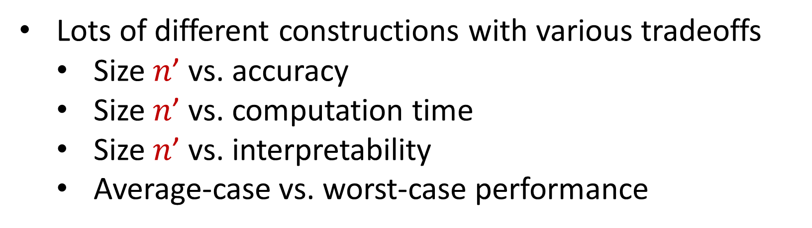
Coreset
Lots of different constructions with various tradeoffs
Size $n$’ vs. accuracy
Size $n$’ vs. computation time
Size $n$’ vs. interpretability
Average-case vs. worst-case performance

Slide 24
New Coreset Constructions
Coresets for data-independent neural pruning [MOBZF20]
Coresets for projective clustering [TWZBF22]
Coresets for regression on structured matrices [MMMWZF22]
Online coresets for linear algebra [BDMMUWZ20]
General coreset construction framework through sensitivity sampling [BFLSZ21]

Slide 25
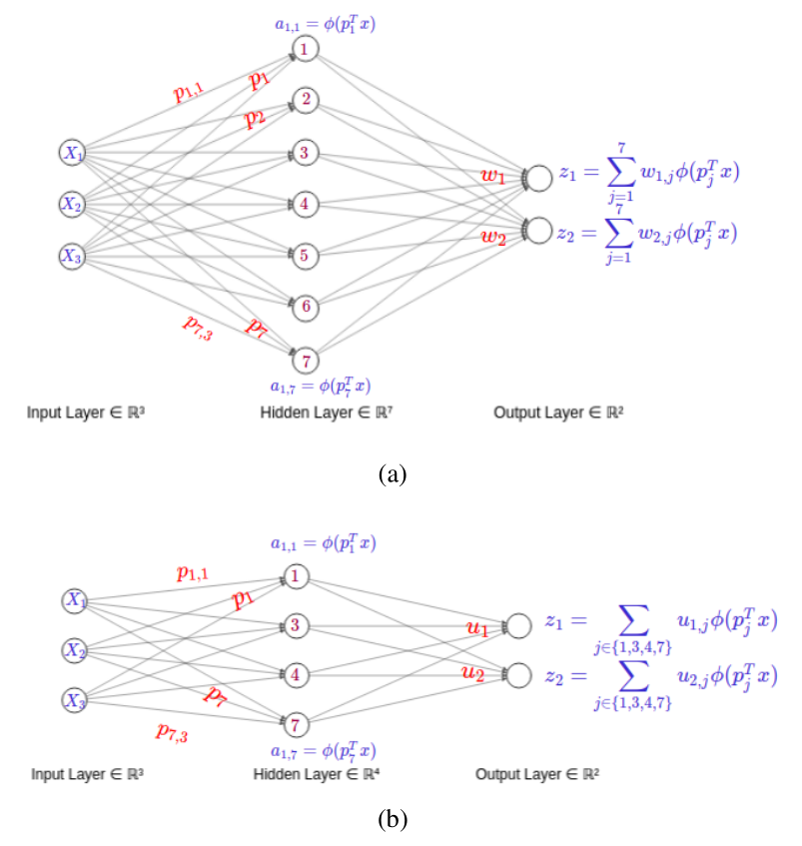
[MOBZF20]

Slide 26
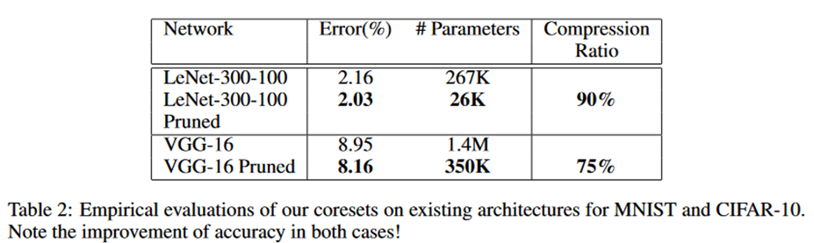
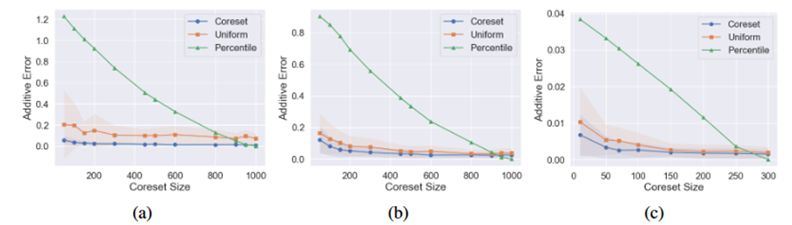
[MOBZF20]
Notes:
LeNet-300-100 is a multi-layer perceptron with two fully connected hidden layers with 300 and 100 neurons correspondingly, trained on MNIST data set. VGG-16 includes 5 blocks comprising convolutional and pooling layers, followed by 3 dense layers – the first two with 4096 neurons and the last with 1000 neurons. The model was trained and tested on CIFAR-10
Lottery ticket hypothesis

Slide 27
Evolving Demands
Sublinear-time or sublinear-space algorithms
Incorporation of advice
Security for data science
Robustness to noise or adversarial input
Ability to handle time-sensitive data

Slide 28
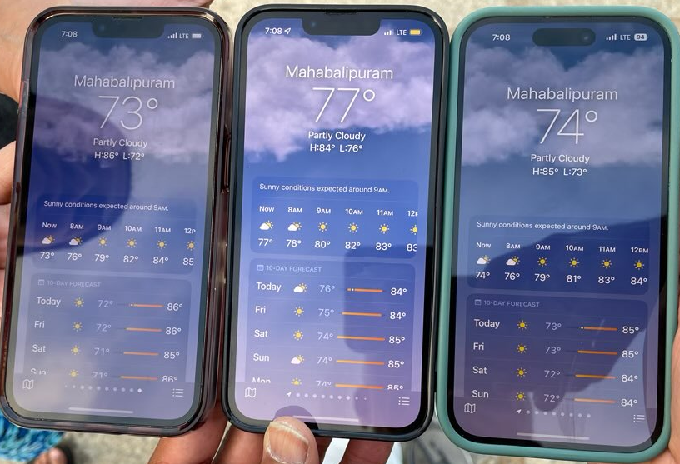

Slide 29

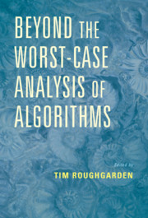
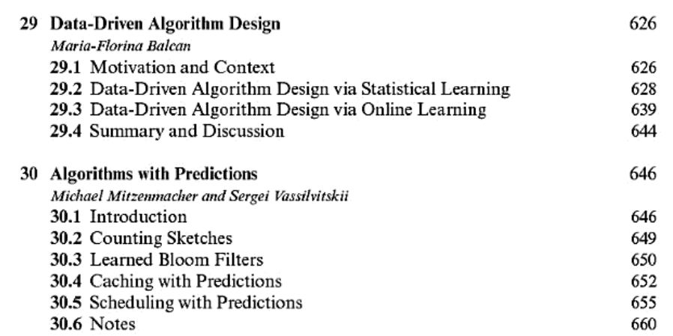

Slide 30
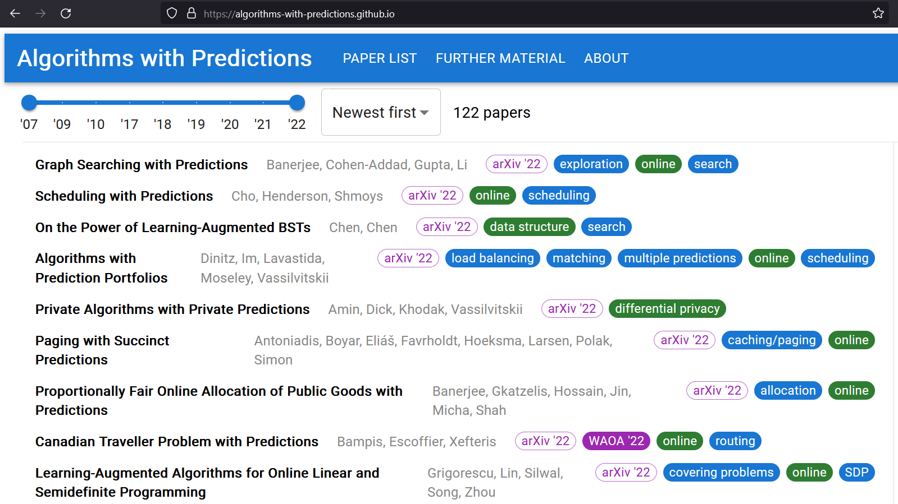

Slide 31
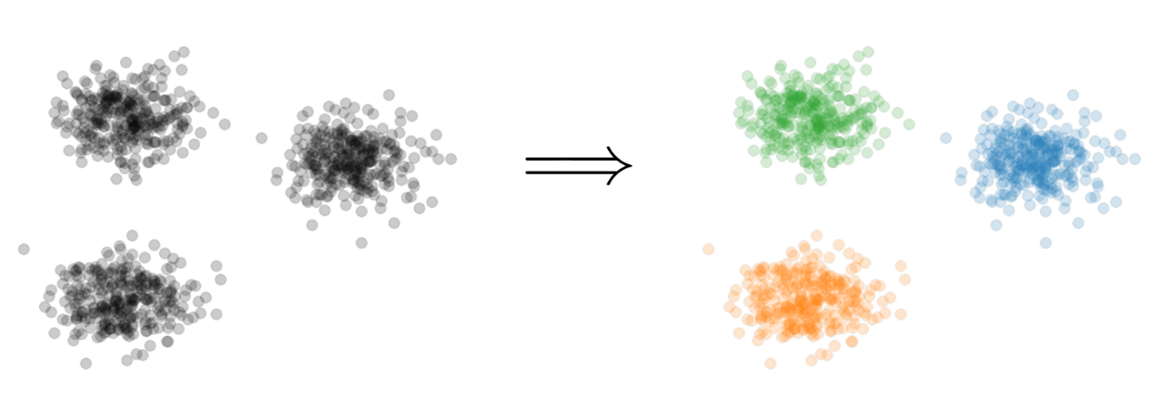

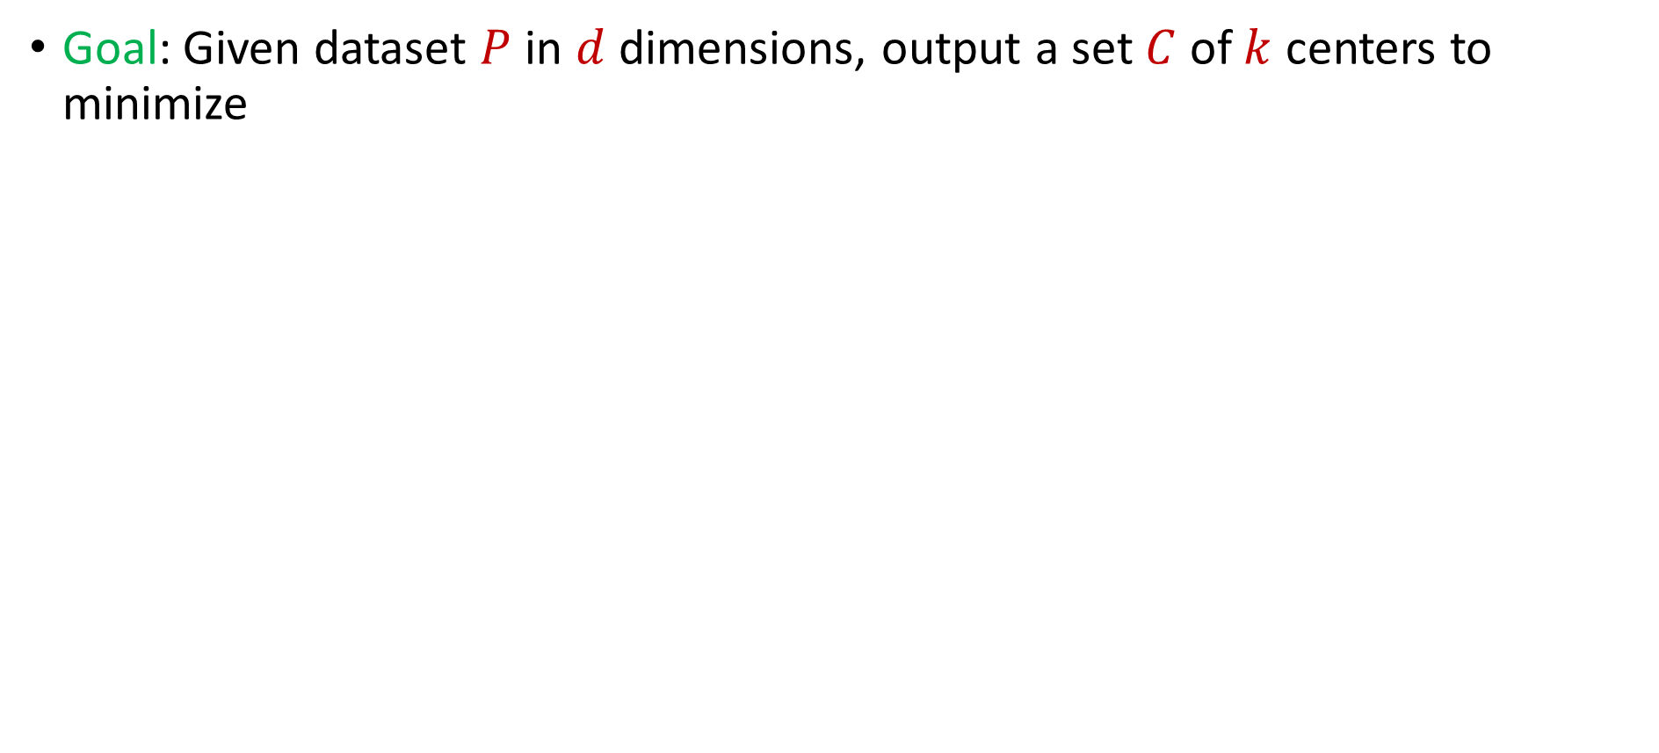
Learning-Augmented Clustering
Goal: Given dataset $P$ in $d$ dimensions, output a set $C$ of $k$ centers to minimize
$$\sum_{p∈P}{{\min_{c∈C}\left\|p−c\right\|}_{2}^{2}}$$

Slide 32
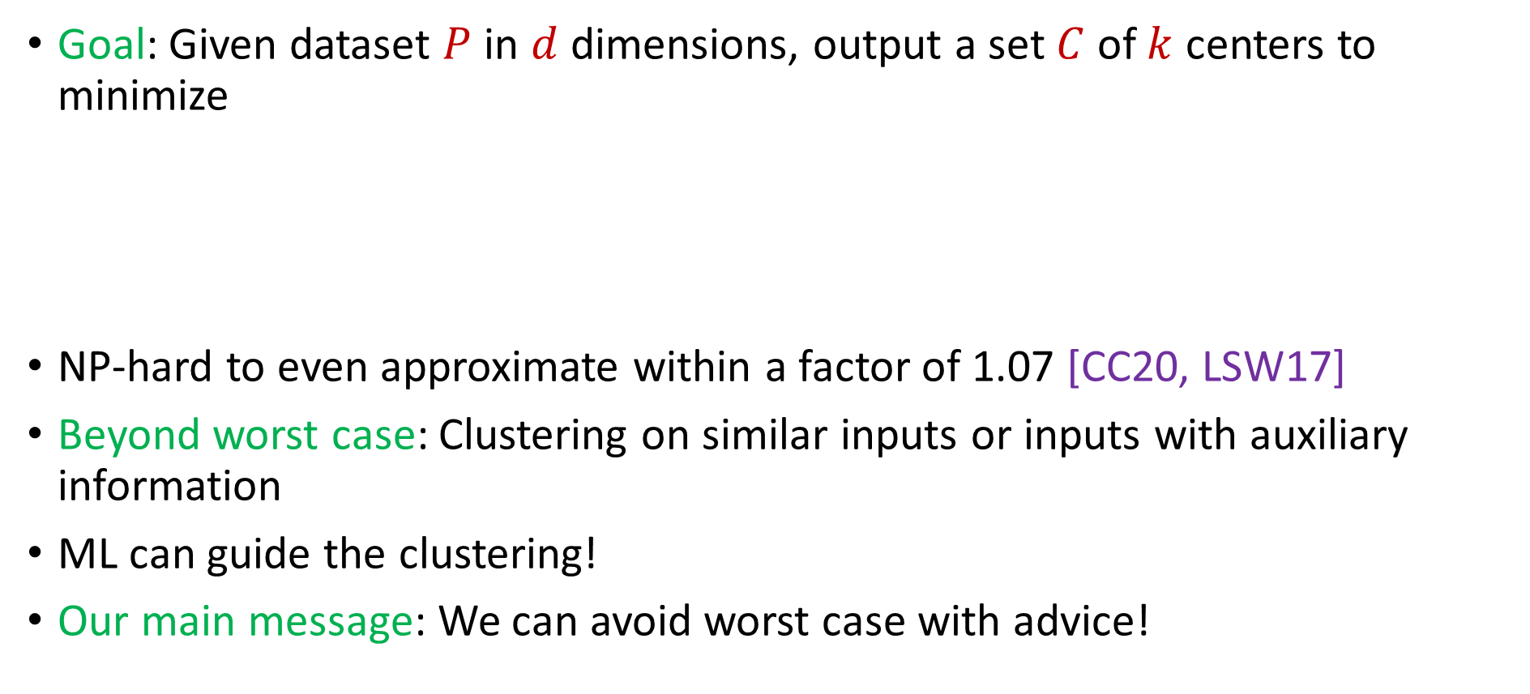
Learning-Augmented Clustering
Goal: Given dataset $P$ in $d$ dimensions, output a set $C$ of $k$ centers to minimize
NP-hard to even approximate within a factor of 1.07 [CC20, LSW17]
Beyond worst case: Clustering on similar inputs or inputs with auxiliary information
ML can guide the clustering!
Our main message: We can avoid worst case with advice!
$$\sum_{p∈P}{{\min_{c∈C}\left\|p−c\right\|}_{2}^{2}}$$
Notes:
[Cohen-AddadC.S.20], [LeeSchmidtWright17]

Slide 33
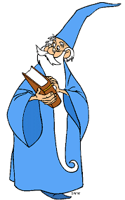
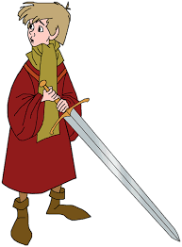
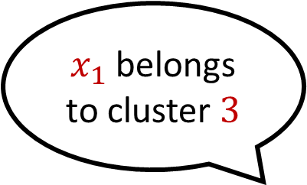
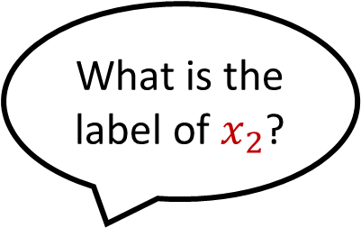

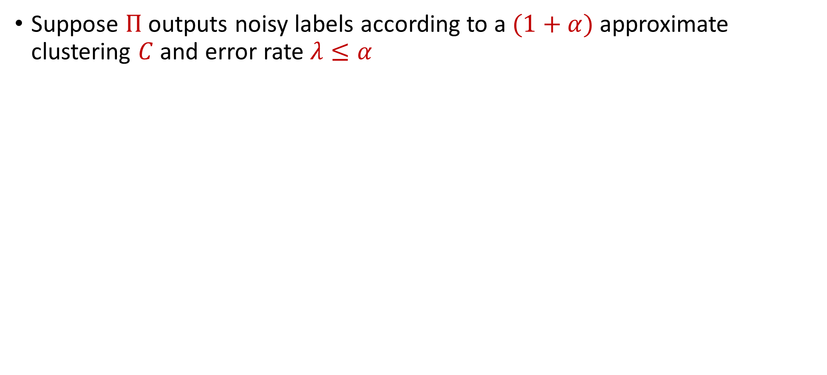
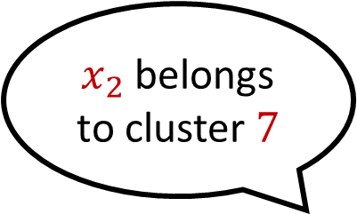
Predictor
Suppose $Π$ outputs noisy labels according to a $(1+α)$approximate clustering $C$ and error rate $λ≤α$
What is the label of $x_{1}$?
$x_{1}$ belongs to cluster $3$
What is the label of $x_{2}$?
$x_{2}$ belongs to cluster $7$

Slide 34
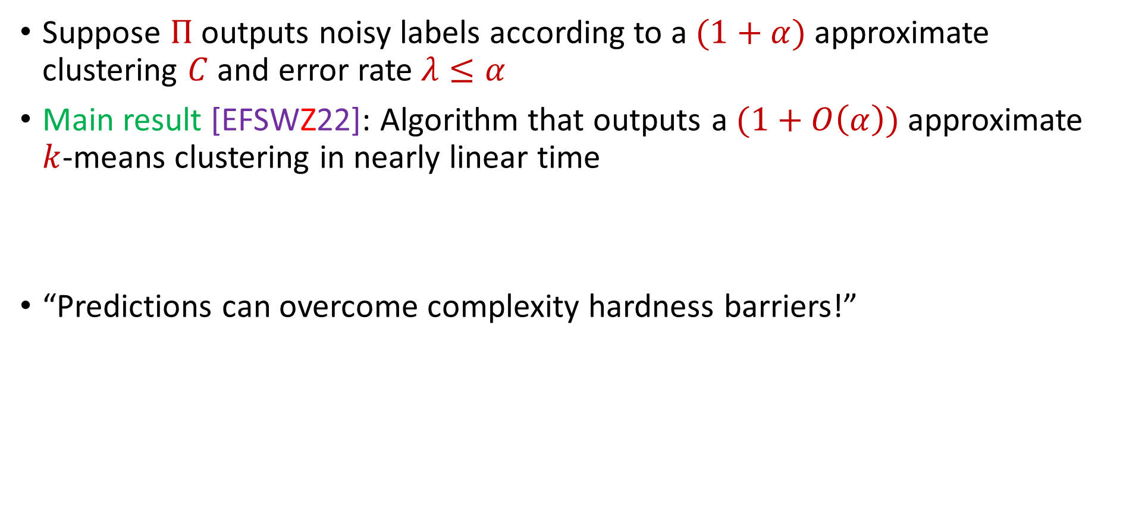
Theoretical Guarantee
Suppose $Π$ outputs noisy labels according to a $(1+α)$approximate clustering $C$ and error rate $λ≤α$
Main result [EFSWZ22]: Algorithm that outputs a $(1+O\left(α\right))$approximate $k$-means clustering in nearly linear time
“Predictions can overcome complexity hardness barriers!”

Slide 35
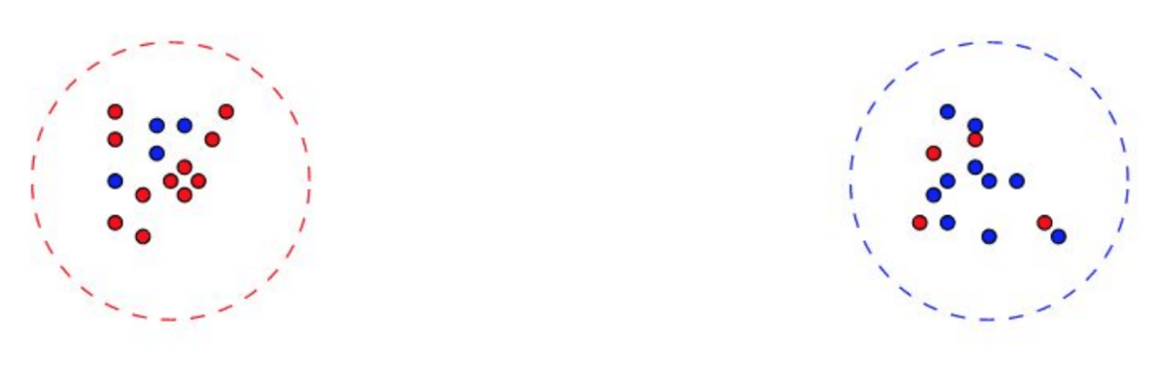
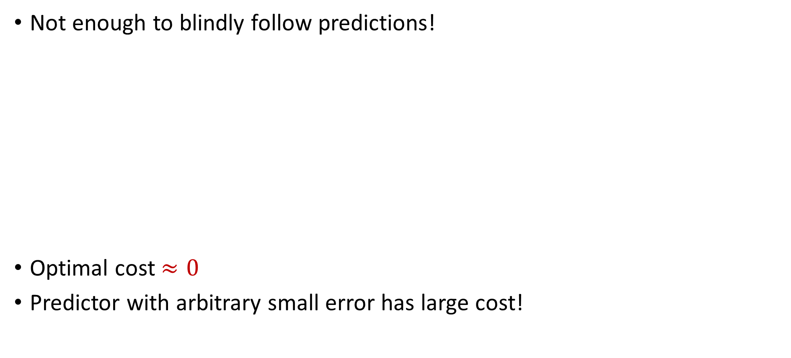
Algorithmic Intuition
Not enough to blindly follow predictions!
Optimal cost $≈0$
Predictor with arbitrary small error has large cost!
Notes:
Draw box

Slide 36
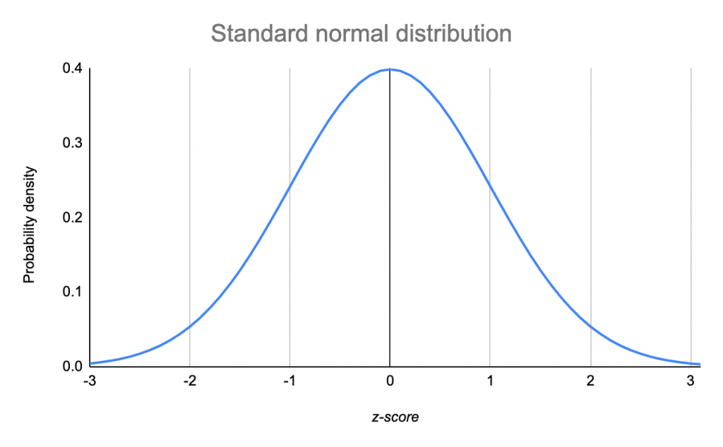
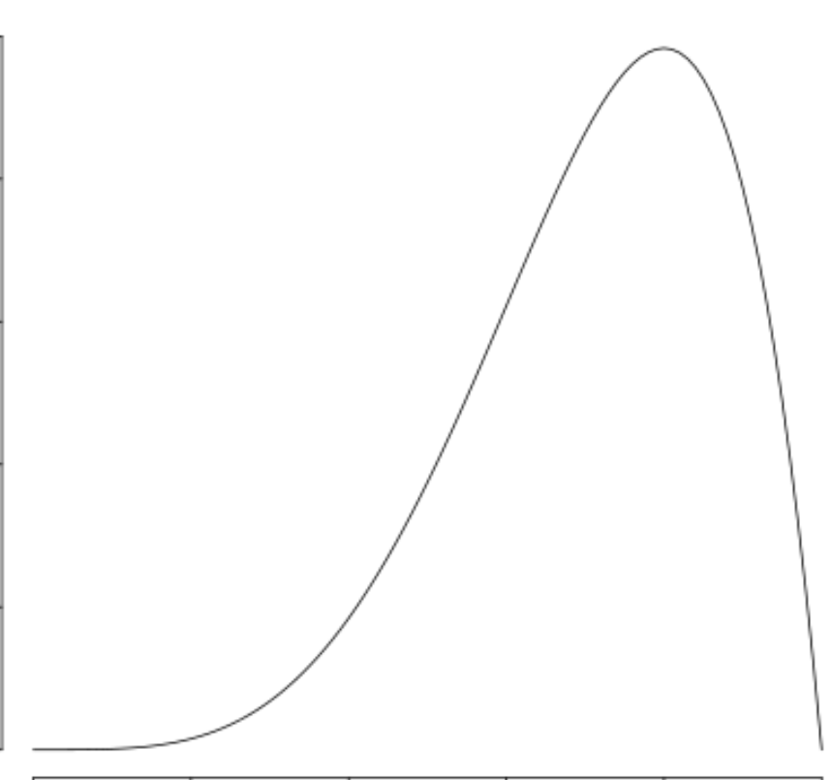
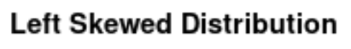


Algorithmic Intuition
Not enough to blindly follow predictions!
Our approach: Use ideas from robust mean estimation
$$\left(1−ε\right)P$$
$$εQ$$

Slide 37
Algorithmic Intuition
Not enough to blindly follow predictions!
Our approach: Use ideas from robust mean estimation
$$\left(1−ε\right)P$$
$$εQ$$

Slide 38
Algorithmic Intuition
Not enough to blindly follow predictions!
Our approach: Use ideas from robust mean estimation
$$\left(1−ε\right)P$$
$$εQ$$
Notes:
No need for interval

Slide 39
Algorithmic Intuition
Not enough to blindly follow predictions!
Our approach: Use ideas from robust mean estimation
We exploit the fact that cluster centers are means of points!

Slide 40
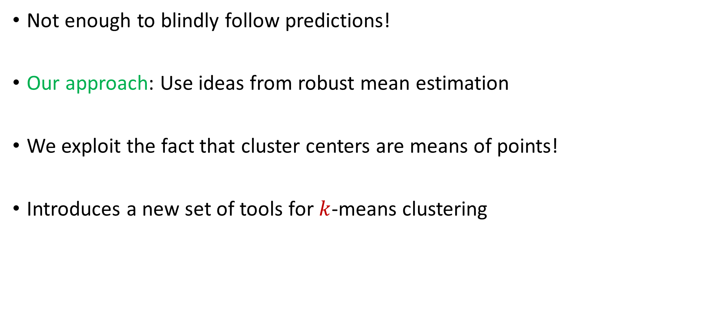
Algorithmic Intuition
Not enough to blindly follow predictions!
Our approach: Use ideas from robust mean estimation
We exploit the fact that cluster centers are means of points!
Introduces a new set of tools for $k$-means clustering

Slide 41
Experimental Results
Case Study: Spectral clustering on graphs varying over time
Dataset: Internet router graph varying over the course of a year
Methodology: Compare to standard benchmarks while using various natural predictors, i.e., noisily perturb true labels and compare to baselines as function of error
Notes:
Experiments unclear (spectral clustering)

Slide 42
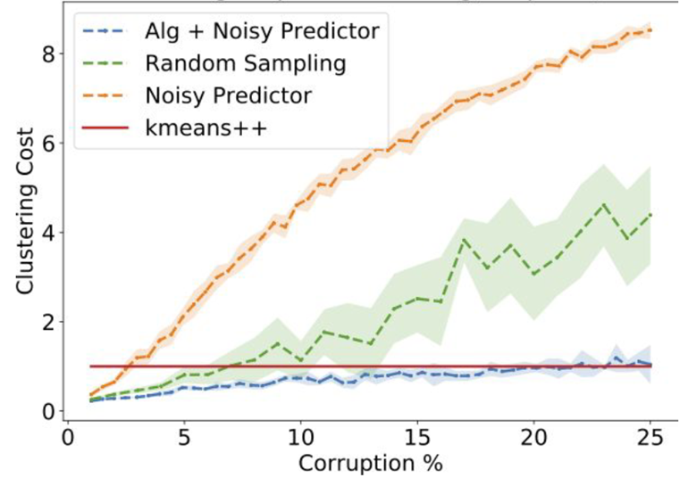
Dataset: Internet router graph varying over the course of a year, $k=10$
Conclusion: Our algorithm (using predictor) outperforms benchmarks such as $k$-means ++ for low error while staying competitive with high corruptions
Notes:
Change title

Slide 43
My Recent Work on New Data Science Tools
Learning-Augmented k-means Clustering (ICLR 2022)
Fast Regression for Structured Inputs (ICLR 2022)
New Coresets for Projective Clustering and Applications (AISTATS 2022)
Dimensionality Reduction for Wasserstein Barycenter (NeurIPS 2021)
Learning a Latent Simplex in Input Sparsity Time (ICLR 2021)
Near Optimal Linear Algebra in the Online and Sliding Window Models (FOCS 2020)
Data-Independent Neural Pruning via Coresets (ICLR 2020)
Adversarially Robust Submodular Maximization under Knapsack Constraints (KDD 2019)

Slide 44
Questions?

Slide 45
Security for Data Science
Security for Data Science

Slide 46
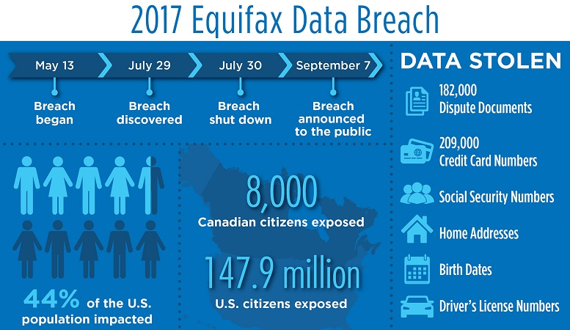
“Equifax agreed to a $700 million settlement over the privacy breach, but $425 million of that was set aside to repay consumers as a restitution fund.”
Notes:
Credit bureau company, delete $125?
Equifax Inc. is an American multinational consumer credit reporting agency headquartered in Atlanta, Georgia and is one of the three largest consumer credit reporting agencies, along with Experian and TransUnion (together known as the "Big Three"). With over 14,000 employees worldwide, Equifax has nearly US$5 billion in annual revenue and is traded on the New York Stock Exchange (NYSE) under the symbol EFX

Slide 47











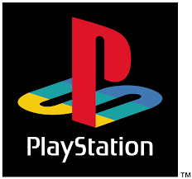
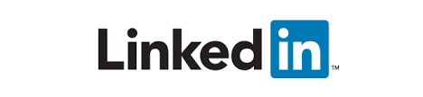


Slide 48

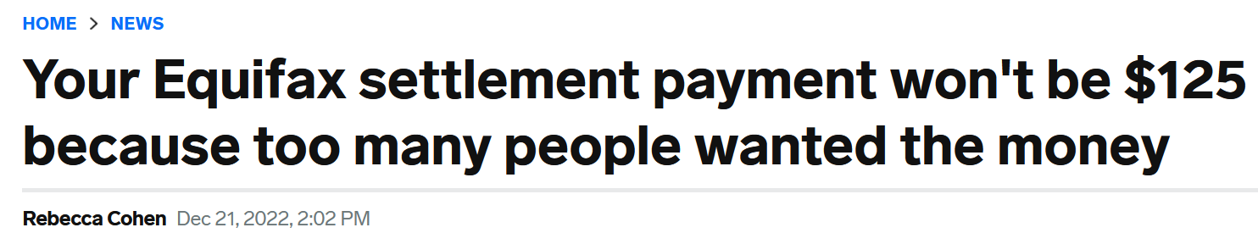
“Equifax agreed to a $700 million settlement over the privacy breach, but $425 million of that was set aside to repay consumers as a restitution fund.”
Notes:
Credit bureau company, delete $125?
Equifax Inc. is an American multinational consumer credit reporting agency headquartered in Atlanta, Georgia and is one of the three largest consumer credit reporting agencies, along with Experian and TransUnion (together known as the "Big Three"). With over 14,000 employees worldwide, Equifax has nearly US$5 billion in annual revenue and is traded on the New York Stock Exchange (NYSE) under the symbol EFX

Slide 49
Evolving Demands
Sublinear-time or sublinear-space algorithms
Incorporation of advice
Security for data science
Robustness to noise or adversarial input
Ability to handle time-sensitive data

Slide 50
Graph Theory for Memory Hard Functions
pwd
$$h_{1}$$
$$h_{2}$$
$$h_{3}$$
$$h_{5}$$
$$h_{4}$$

Slide 51
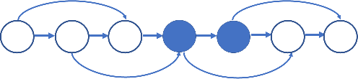
Graph Theory for Memory Hard Functions
Proved the security benefits of memory-hard functions using an economic marginal cost-revenue analysis [BHZ18]
Showed the hardness of computing [BZ18] and approximating the computational cost [BLZ20] of graph pebbling
Applied graph theory to cryptanalyze the computational complexity of memory-hard functions [BZ18, BRZ18]

Slide 52
My Recent Work on Security for Data Science
On the Security of Proofs of Sequential Work in a Post-Quantum World (ITC 2021)
Approximating Cumulative Pebbling Cost is Unique Games Hard (ITCS 2020)
Computationally Data-Independent Memory Hard Functions (ITCS 2020)
Data-Independent Memory Hard Functions: New Attacks and Stronger Constructions (CRYPTO 2019)
Bandwidth-Hard Functions: Reductions and Lower Bounds (CCS 2018)
On the Economics of Offline Password Cracking (Security and Privacy 2018)
On the Depth-Robustness and Cumulative Pebbling Cost of Argon2i (TCC 2017)

Slide 53
Sublinear Algorithms for Processing Big Data
Sublinear Algorithms for Processing Big Data

Slide 54
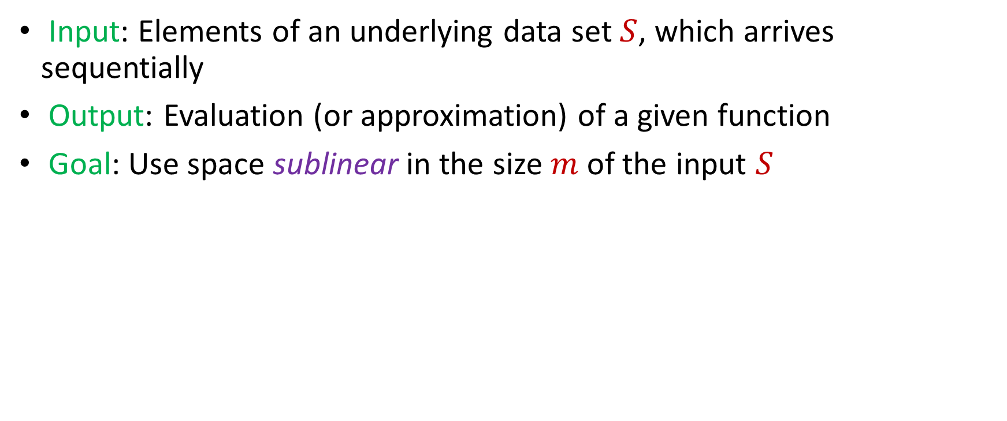
Model #1: Streaming Model
Input: Elements of an underlying data set $S$, which arrives sequentially
Output: Evaluation (or approximation) of a given function
Goal: Use space sublinear in the size $m$of the input $S$
1 0 1 1 1 0 0 1

Slide 55


Frequency Vector
Given a set $S$ of $m$ elements from $[n]$, let $f_{i}$ be the frequency of element $i$. (How often it appears)
1 1 2 1 2 1 1 2 3  $\left[5, 3, 1, 0\right]≔f$

Slide 56


Heavy-Hitters (Frequent Items)
Given a set $S$ of $m$ elements from $[n]$, let $f_{i}$ be the frequency of element $i$. (How often it appears)
Let $L_{2}$ be the norm of the frequency vector:
Goal: Given a set $S$ of $m$ elements from $[n]$ and a threshold $ε$, output the elements $i$ such that $f_{i}>$ $ε L_{2}$...and no elements $j$ such that $f_{j}<$ $\frac{ε}{16} L_{2}$
Motivation: DDoS prevention, iceberg queries
$$L_{2}=\sqrt{f_{1}^{2}+f_{2}^{2}+…+f_{n}^{2}}$$

Slide 57



Frequency Moments ($L_{p}$ Norm)
Given a set $S$ of $m$ elements from $[n]$, let $f_{i}$ be the frequency of element $i$. (How often it appears)
Let $F_{p}$ be the frequency moment of the vector:
Goal: Given a set $S$ of $m$ elements from $[n]$ and an accuracy parameter $ε$, output a $(1+ε)$-approximation to $F_{p}$
Motivation: Entropy estimation, linear regression
$F_{p}=$ $f_{1}^{p}+f_{2}^{p}+…+f_{n}^{p}$

Slide 58


Distinct Elements ($F_{0}$ Estimation)
Given a set $S$ of $m$ elements from $[n]$, let $f_{i}$ be the frequency of element $i$. (How often it appears)
Let $F_{0}$ be the frequency moment of the vector:
Goal: Given a set $S$ of $m$ elements from $[n]$ and an accuracy parameter $ε$, output a $(1+ε)$-approximation to $F_{0}$
Motivation: Traffic monitoring
$F_{0}=$ $|\{i :f_{i}≠0\}|$

Slide 59


$\left(1+ε\right)$-Approximation Streaming Algorithms
$Θ\left(\frac{1}{ε^{2}}\right)$ space-accuracy tradeoff for distinct elements, i.e., $F_{0}$ [KNW10, Blasiok20]
$Θ\left(\frac{1}{ε^{2}}\right)$ space-accuracy tradeoff for $F_{p}$ with $p∈\left(0, 2\right]$ [BDN17]
$Θ\left(\frac{1}{ε^{2}}\right)$ space-accuracy tradeoff for $F_{p}$ with $p>2$ [Ganguly11, GW18]
$Θ\left(\frac{1}{ε^{2}}\right)$ space-accuracy tradeoff for $L_{2}$-heavy hitters [BCINWW17]
Notes:
[KaneNelsonWoodruff10], [Blasiok20], [BlasiokDingNelson17], [Ganguly11, GangulyWoodruff18], [BravermanChestnutIvkinNelsonWangWoodruff17]

Slide 60
Evolving Demands
Sublinear-time or sublinear-space algorithms
Incorporation of advice
Security for data science
Robustness to noise or adversarial input
Ability to handle time-sensitive data

Slide 61


Human readers will easily identify the image as showing two men on skis. Google’s Cloud Vision service reported being 91 percent certain it saw a dog. Other stunts have shown how to make stop signs invisible, or audio that sounds benign to humans but is transcribed by software as “OK Google browse to evil dot com.”

Slide 62


Slide 63



Model #2: Adversarially Robust Streaming
Input: Elements of an underlying data set $S$, which arrives sequentially and adversarially
Output: Evaluation (or approximation) of a given function
Goal: Use space sublinear in the size $m$of the input $S$
1
1
Notes:
Let’s start by breaking down each of the terms in the title. To understand the sliding window model, we first have to understand the streaming model of computation, in which elements of an underlying data set S, arrive sequentially and the goal is to evaluate or approximate some given function on this dataset, using space sublinear in S. In the sliding window model, only the W most recent updates form the underlying data set

Slide 64
Model #2: Adversarially Robust Streaming
Input: Elements of an underlying data set $S$, which arrives sequentially and adversarially
Output: Evaluation (or approximation) of a given function
Goal: Use space sublinear in the size $m$of the input $S$
10
1
Notes:
Let’s start by breaking down each of the terms in the title. To understand the sliding window model, we first have to understand the streaming model of computation, in which elements of an underlying data set S, arrive sequentially and the goal is to evaluate or approximate some given function on this dataset, using space sublinear in S. In the sliding window model, only the W most recent updates form the underlying data set

Slide 65
Model #2: Adversarially Robust Streaming
Input: Elements of an underlying data set $S$, which arrives sequentially and adversarially
Output: Evaluation (or approximation) of a given function
Goal: Use space sublinear in the size $m$of the input $S$
101
2
Notes:
Let’s start by breaking down each of the terms in the title. To understand the sliding window model, we first have to understand the streaming model of computation, in which elements of an underlying data set S, arrive sequentially and the goal is to evaluate or approximate some given function on this dataset, using space sublinear in S. In the sliding window model, only the W most recent updates form the underlying data set

Slide 66
Model #2: Adversarially Robust Streaming
Input: Elements of an underlying data set $S$, which arrives sequentially and adversarially
Output: Evaluation (or approximation) of a given function
Goal: Use space sublinear in the size $m$of the input $S$
1010
3
Notes:
Let’s start by breaking down each of the terms in the title. To understand the sliding window model, we first have to understand the streaming model of computation, in which elements of an underlying data set S, arrive sequentially and the goal is to evaluate or approximate some given function on this dataset, using space sublinear in S. In the sliding window model, only the W most recent updates form the underlying data set

Slide 67

Model #2: Adversarially Robust Streaming
Input: Elements of an underlying data set $S$, which arrives sequentially and adversarially
Output: Evaluation (or approximation) of a given function
Goal: Use space sublinear in the size $m$of the input $S$
1010
3
Notes:
Let’s start by breaking down each of the terms in the title. To understand the sliding window model, we first have to understand the streaming model of computation, in which elements of an underlying data set S, arrive sequentially and the goal is to evaluate or approximate some given function on this dataset, using space sublinear in S. In the sliding window model, only the W most recent updates form the underlying data set

Slide 68


$\left(1+ε\right)$-Robust Algorithms [WZ21]
$\tilde{Θ}\left(\frac{1}{ε^{2}}\right)$ space-accuracy tradeoff for distinct elements, i.e., $F_{0}$
$\tilde{Θ}\left(\frac{1}{ε^{2}}\right)$ space-accuracy tradeoff for $F_{p}$ with $p∈\left(0, 2\right]$
$\tilde{Θ}\left(\frac{1}{ε^{2}}\right)$ space-accuracy tradeoff for $F_{p}$ with integer $p>2$
$\tilde{Θ}\left(\frac{1}{ε^{2}}\right)$ space-accuracy tradeoff for $L_{2}$-heavy hitters
“No losses* are necessary!”
Notes:
[KaneNelsonWoodruff10], [Blasiok20], [BlasiokDingNelson17], [Ganguly11, GangulyWoodruff18], [BravermanChestnutIvkinNelsonWangWoodruff17]

Slide 69



Slide 70


Robust Algorithms
Goal: $\tilde{Θ}\left(\frac{1}{ε^{2}}\right)$ space
$$S$$
1 0 1 1 1 0 0 1 1 0 0 1 0 1 …

Slide 71


Robust Algorithms
Goal: $\tilde{Θ}\left(\frac{1}{ε^{2}}\right)$ space
$$h$$
$\left(1+ε\right)$ approximation to
Monotonic function $h$
$$S$$
1 0 1 1 1 0 0 1 1 0 0 1 0 1 …

Slide 72











Robust Algorithms
Goal: $\tilde{Θ}\left(\frac{1}{ε^{2}}\right)$ space
$$h$$
Monotonic function $h$
Consider times when $h$ increases by $(1+ε)$
$$t_{1}$$
$$t_{2}$$
$$t_{3}$$
$$t_{4}$$
$$t_{5}$$
$$S$$
$$F$$
$${\left(1+ε\right)}^{2}F$$
$${\left(1+ε\right)}^{4}F$$
$$\left(1+ε\right)F$$
$${\left(1+ε\right)}^{3}F$$

Slide 73

Robust Algorithms
Goal: $\tilde{Θ}\left(\frac{1}{ε^{2}}\right)$ space
$$h$$
Monotonic function $h$
Consider times when $h$ increases by $(1+ε)$
Correctness at these times suffice!
$$t_{1}$$
$$t_{2}$$
$$t_{3}$$
$$t_{4}$$
$$t_{5}$$
$$S$$
$$F$$
$${\left(1+ε\right)}^{2}F$$
$${\left(1+ε\right)}^{4}F$$
$$\left(1+ε\right)F$$
$${\left(1+ε\right)}^{3}F$$

Slide 74







Robust Algorithms
Goal: $\tilde{Θ}\left(\frac{1}{ε^{2}}\right)$ space
Initialize many instances of the streaming algorithm
Use a new instance of the algorithm each time the function increases by $(1+ε)$
$$h$$
$$S$$
$$F$$
$${\left(1+ε\right)}^{2}F$$
$${\left(1+ε\right)}^{4}F$$
$$\left(1+ε\right)F$$
$${\left(1+ε\right)}^{3}F$$

Slide 75
Robust Algorithms
Goal: $\tilde{Θ}\left(\frac{1}{ε^{2}}\right)$ space
Initialize many instances of the streaming algorithm
Use a new instance of the algorithm each time the function increases by $(1+ε)$
1
Example: Number of ones in the stream (2-approximation)
1
1
1
1

Slide 76
Robust Algorithms
Goal: $\tilde{Θ}\left(\frac{1}{ε^{2}}\right)$ space
Initialize many instances of the streaming algorithm
Use a new instance of the algorithm each time the function increases by $(1+ε)$
1 0
Example: Number of ones in the stream (2-approximation)
1
1
1
1

Slide 77
Robust Algorithms
Goal: $\tilde{Θ}\left(\frac{1}{ε^{2}}\right)$ space
Initialize many instances of the streaming algorithm
Use a new instance of the algorithm each time the function increases by $(1+ε)$
1 0 1
Example: Number of ones in the stream (2-approximation)
1
2
2
2

Slide 78
Robust Algorithms
Goal: $\tilde{Θ}\left(\frac{1}{ε^{2}}\right)$ space
Initialize many instances of the streaming algorithm
Use a new instance of the algorithm each time the function increases by $(1+ε)$
1 0 1
Example: Number of ones in the stream (2-approximation)
1
2
2
2

Slide 79

Robust Algorithms
Goal: $\tilde{Θ}\left(\frac{1}{ε^{2}}\right)$ space
Initialize many instances of the streaming algorithm
Use a new instance of the algorithm each time the function increases by $(1+ε)$
1 0 1 1
Example: Number of ones in the stream (2-approximation)
1
2
3
3

Slide 80
Robust Algorithms
Goal: $\tilde{Θ}\left(\frac{1}{ε^{2}}\right)$ space
Initialize many instances of the streaming algorithm
Use a new instance of the algorithm each time the function increases by $(1+ε)$
1 0 1 1 1
Example: Number of ones in the stream (2-approximation)
1
2
4
4

Slide 81
Robust Algorithms
Goal: $\tilde{Θ}\left(\frac{1}{ε^{2}}\right)$ space
Initialize many instances of the streaming algorithm
Use a new instance of the algorithm each time the function increases by $(1+ε)$
1 0 1 1 1
Example: Number of ones in the stream (2-approximation)
1
2
4
4

Slide 82
Robust Algorithms
Goal: $\tilde{Θ}\left(\frac{1}{ε^{2}}\right)$ space
Initialize many instances of the streaming algorithm
Use a new instance of the algorithm each time the function increases by $(1+ε)$
1 0 1 1 1 0 0 1 1 0 1
Example: Number of ones in the stream (2-approximation)
Number of ones stream is at least 4 and at most 8
4 is a good approximation
1
2
4
7

Slide 83

Intuition
Goal: $\tilde{Θ}\left(\frac{1}{ε^{2}}\right)$ space
Approach uses $\frac{1}{ε^{2}}$ space each time function increases by $(1+ε)$ and function increases $\frac{1}{ε}$ times
Total space: $\frac{1}{ε^{2}}×\frac{1}{ε}=\tilde{O}\left(\frac{1}{ε^{3}}\right)$
1 0 1 1 1 0 0 1 1 0 1
1
2
4
7

Slide 84

Intuition
Goal: $\tilde{Θ}\left(\frac{1}{ε^{2}}\right)$ space
Approach uses $\frac{1}{ε^{2}}$ space each time function increases by $(1+ε)$ and function increases $\frac{1}{ε}$ times for total space $\tilde{O}\left(\frac{1}{ε^{3}}\right)$
Do we really need to pay $\frac{1}{ε^{2}}$ space each time function increases by $(1+ε)$?

Slide 85

Intuition
Goal: $\tilde{Θ}\left(\frac{1}{ε^{2}}\right)$ space
Approach uses $\frac{1}{ε^{2}}$ space each time function increases by $(1+ε)$ and function increases $\frac{1}{ε}$ times for total space $\tilde{O}\left(\frac{1}{ε^{3}}\right)$
Do we really need to pay $\frac{1}{ε^{2}}$ space each time function increases by $(1+ε)$?
$$F$$

Slide 86

Intuition
Goal: $\tilde{Θ}\left(\frac{1}{ε^{2}}\right)$ space
Approach uses $\frac{1}{ε^{2}}$ space each time function increases by $(1+ε)$ and function increases $\frac{1}{ε}$ times for total space $\tilde{O}\left(\frac{1}{ε^{3}}\right)$
Do we really need to pay $\frac{1}{ε^{2}}$ space each time function increases by $(1+ε)$?
$$F$$
$$(1+ε)F$$

Slide 87

Intuition
Goal: $\tilde{Θ}\left(\frac{1}{ε^{2}}\right)$ space
$$F$$
$$εF$$

Slide 88

Intuition
Goal: $\tilde{Θ}\left(\frac{1}{ε^{2}}\right)$ space
Only need constant factor approximation to $εF$
$$F$$
$$εF$$

Slide 89

Intuition
Goal: $\tilde{Θ}\left(\frac{1}{ε^{2}}\right)$ space
Only need constant factor approximation to $εF$
Only need to pay $\frac{1}{ε}$ space each time function increases by $(1+ε)$
$$F$$
$$εF$$

Slide 90

Intuition
Goal: $\tilde{Θ}\left(\frac{1}{ε^{2}}\right)$ space
Only need constant factor approximation to $εF$
Only need to pay $\frac{1}{ε}$ space each time function increases by $(1+ε)$
Function increases by $(1+ε)$ a total of $\frac{1}{ε}$ times
$$F$$
$$εF$$

Slide 91

Intuition
Goal: $\tilde{Θ}\left(\frac{1}{ε^{2}}\right)$ space
Only need constant factor approximation to $εF$
Only need to pay $\frac{1}{ε}$ space each time function increases by $(1+ε)$
Function increases by $(1+ε)$ a total of $\frac{1}{ε}$ times
Total space: $\frac{1}{ε}×\frac{1}{ε}=\tilde{Θ}\left(\frac{1}{ε^{2}}\right)$
$$F$$
$$εF$$

Slide 92


Additional Work
[BHMSSZ22] showed that “sampling-based” algorithms achieve adversarial robustness “for-free”
[ABJSSWZ22] showed impossibility results for many natural problems for “white-box” adversaries
[ABJSSWZ22] gave a sublinear-space algorithm for estimating $F_{0}$ when the white-box adversary has polynomial computation time
Open Questions: 1) Is anything non-trivial possible for “black-box” adversaries that are allowed to delete elements? 2) Can lattice-based crypto be used for other algorithms robust to white-box adversaries?

Slide 93
Evolving Demands
Sublinear-time or sublinear-space algorithms
Incorporation of advice
Security for data science
Robustness to noise or adversarial input
Ability to handle time-sensitive data
Notes:
Pictures, too many things, federated learning

Slide 94



“Facebook data policy retains user search histories for 6 months, the Apple differential privacy overview states that collected data is retained for 3 months, the Google data retention policy states that browser information may be stored for up to 9 months”
Notes:
Explicit about slide transition

Slide 95

Model #3: Sliding Window Model
Input: Elements of an underlying data set $S$, which arrives sequentially
Output: Evaluation (or approximation) of a given function
Goal: Use space sublinear in the size $m$of the input $S$
Sliding Window: “Only the $m$ most recent updates form the underlying data set $S$”
1 0 1 1 1 0 0 1
Notes:
Let’s start by breaking down each of the terms in the title. To understand the sliding window model, we first have to understand the streaming model of computation, in which elements of an underlying data set S, arrive sequentially and the goal is to evaluate or approximate some given function on this dataset, using space sublinear in S. In the sliding window model, only the W most recent updates form the underlying data set

Slide 96
Model #3: Sliding Window Model
Input: Elements of an underlying data set $S$, which arrives sequentially
Output: Evaluation (or approximation) of a given function
Goal: Use space sublinear in the size $m$of the input $S$
Sliding Window: “Only the $m$ most recent updates form the underlying data set $S$”
1 0 1 1 1 0 0 1 1

Slide 97
Model #3: Sliding Window Model
Input: Elements of an underlying data set $S$, which arrives sequentially
Output: Evaluation (or approximation) of a given function
Goal: Use space sublinear in the size $m$of the input $S$
Sliding Window: “Only the $m$ most recent updates form the underlying data set $S$”
1 0 1 1 1 0 0 1 1 0

Slide 98

Model #3: Sliding Window Model
Input: Elements of an underlying data set $S$, which arrives sequentially
Output: Evaluation (or approximation) of a given function
Goal: Use space sublinear in the size $m$of the input $S$
Sliding Window: “Only the $m$ most recent updates form the underlying data set $S$”
Emphasizes recent interactions, appropriate for time sensitive settings
1 0 1 1 1 0 0 1 1 0 1
Notes:
The sliding window model emphasizes recent data and thus is appropriate for settings that are time sensitive.

Slide 99



$\left(1+ε\right)$-Approximation Sliding Window Algorithms [WZ21]
Space $\tilde{Θ}\left(\frac{1}{ε^{2}}\right)$ algorithm for $F_{p}$ with $p∈\left(0, 2\right]$ [WZ21]
“No losses* are necessary!”

Slide 100


$\left(1+ε\right)$-Approximation Sliding Window Algorithms [BGLWZ18]
$\tilde{Θ}\left(\frac{1}{ε^{2}}\right)$ space-accuracy tradeoff for $F_{0}$, i.e., distinct elements
$\tilde{Θ}\left(\frac{1}{ε^{2}}\right)$ space-accuracy tradeoff for $L_{2}$-heavy hitters
We give nearly tight new upper and lower bounds for these problems!

Slide 101

RandNLA in the Sliding Window Model
First algorithms for problems in numerical linear algebra in the sliding window model [BDMMUWZ20]
$O\left(d^{2}\right)$space randomized sliding window algorithm for spectral sparsification (space optimal, up to lower order terms)
$O\left(dk\right)$space randomized sliding window algorithm for low-rank approximation (space optimal, up to lower order terms)
$O\left(d^{3}\right)$space randomized sliding window algorithm for $ℓ_{1}$ subspace embedding
Notes:
In this talk, we’ll focus on a space-optimal algorithm for spectral sparsification and then I’ll talk about how to modify the algorithm to get a space-optimal algorithm for low-rank approximation. Before I begin though, I’d like to advertise some other results in this work that I think are really interesting. We also get a deterministic algorithm for spectral sparsification. That’s not space optimal like the randomized algorithm but it presents a natural way of thinking about this problem that is a generalization of smooth histogram framework. We also get sliding window algorithms for L1 subspace embedding with bit complexity assumptions as well as matrix multiplication. Finally, we obtain a number of algorithms for numerical linear algebra in the online setting, which is a cool model that the next speaker will talk about.

Slide 102
My Recent Work on Sublinear Algorithms
Memory Bounds for the Experts Problem (STOC 2022)
The White-Box Adversarial Data Stream Model (PODS 2022)
Truly Perfect Samplers for Data Streams and Sliding Windows (PODS 2022)
Noisy Boolean Hidden Matching with Applications (ITCS 2022)
Adversarial Robustness of Streaming Algorithms through Importance Sampling (NeurIPS 2021)
Tight Bounds for Adversarially Robust Streams and Sliding Windows via Difference Estimators (FOCS 2021)
Separations for Estimating Large Frequency Moments on Data Streams (ICALP 2021)
Non-Adaptive Adaptive Sampling on Turnstile Streams (STOC 2020)

Slide 103

Future Research Directions
Adversarial robustness for data science/ML
Limits of learning-augmented algorithms, beyond NP-hardness, better utility bounds for DP
Data science with fairness considerations
Evolving demands of the future!
Notes:
https://marwahaha.github.io/arxiv-wordcloud/?author=Samson%20Zhou

Slide 104
Future Agenda
Department research: interdisciplinary collaborations
Department activities: social hour, reading group, lunch seminar
Regional activities: Boston Theory Day, Boston Data Science Day
Teaching: Randomized algorithms / mathematical toolkit (hashing, concentration inequalities, linear programming, convex optimization), “modern” data science (dimensionality reduction, clustering, sublinear algorithms)
Funding!: NSF, NIH, DARPA, Apple, Google, Meta, Microsoft

Slide 105
Thank You!

Slide 106
























Thank You!

Slide 107
iMHFs
$$f_{G,H}$$
Hash function: $H$

Slide 108

iMHFs
$$f_{G,H}$$
pwd
$$h_{1}$$
$$h_{1}=H(pwd, salt)$$

Slide 109
iMHFs
$$f_{G,H}$$
pwd
$$h_{1}$$
$$h_{2}$$
$$h_{2}=H(h_{1})$$

Slide 110
iMHFs
$$f_{G,H}$$
pwd
$$h_{1}$$
$$h_{2}$$
$$h_{3}$$
$$h_{4}$$
$$h_{3}=H\left(h_{1},h_{2}\right), { h}_{4}=H(h_{2})$$

Slide 111
iMHFs
$$f_{G,H}$$
pwd
$$h_{1}$$
$$h_{2}$$
$$h_{3}$$
$$h_{5}$$
$$h_{4}$$
$$h_{5}=H\left(h_{3},h_{4}\right)$$

Slide 112


Robust Algorithms
Goal: $\tilde{Θ}\left(\frac{1}{ε^{2}}\right)$ space
$$h$$
Monotonic function $h$
Consider times when $h$ increases by $(1+ε)$
$$t_{1}$$
$$t_{2}$$
$$t_{3}$$
$$t_{4}$$
$$t_{5}$$
$$S$$
$$F$$
$${\left(1+ε\right)}^{2}F$$
$${\left(1+ε\right)}^{4}F$$
$$\left(1+ε\right)F$$
$${\left(1+ε\right)}^{3}F$$
$X$
If $X$ is a $(1+ε)$-approximation to ${\left(1+ε\right)}^{3}F$, then $X$ is a ${\left(1+ε\right)}^{2}$ approximation to all times before ${\left(1+ε\right)}^{4}F$

Slide 113

Robust Algorithms
Goal: $\tilde{Θ}\left(\frac{1}{ε^{2}}\right)$ space
$$h$$
Monotonic function $h$
Consider times when $h$ increases by $(1+ε)$
Correctness at these times suffice!
$$t_{1}$$
$$t_{2}$$
$$t_{3}$$
$$t_{4}$$
$$t_{5}$$
$$S$$
$$F$$
$${\left(1+ε\right)}^{2}F$$
$${\left(1+ε\right)}^{4}F$$
$$\left(1+ε\right)F$$
$${\left(1+ε\right)}^{3}F$$
$X$
If $X$ is a $(1+ε)$-approximation to ${\left(1+ε\right)}^{3}F$, then $X$ is a ${\left(1+ε\right)}^{2}$ approximation to all times before ${\left(1+ε\right)}^{4}F$

Slide 114





Robust Algorithms
Goal: $\tilde{Θ}\left(\frac{1}{ε^{2}}\right)$ space
$$A_{1}$$
$$A_{2}$$
$$A_{3}$$
$$A_{4}$$
$$A_{5}$$
$$S$$
$$F$$
$${\left(1+ε\right)}^{2}F$$
$${\left(1+ε\right)}^{4}F$$
$$\left(1+ε\right)F$$
$${\left(1+ε\right)}^{3}F$$

Slide 115

Robust Algorithms
Goal: $\tilde{Θ}\left(\frac{1}{ε^{2}}\right)$ space
Start many instances of the streaming algorithm at the beginning
Use an instance of the algorithm but “freeze” the output
Each time the next instance has value $(1+O\left(ε\right))$ more than the “frozen” output, use the next instance and “freeze” its output
1
Example: Number of ones in the stream (2-approximation)
1
1
1
1

Slide 116
Robust Algorithms
Goal: $\tilde{Θ}\left(\frac{1}{ε^{2}}\right)$ space
Start many instances of the streaming algorithm at the beginning
Use an instance of the algorithm but “freeze” the output
Each time the next instance has value $(1+O\left(ε\right))$ more than the “frozen” output, use the next instance and “freeze” its output
1 0
Example: Number of ones in the stream (2-approximation)
1
1
1
1

Slide 117
Robust Algorithms
Goal: $\tilde{Θ}\left(\frac{1}{ε^{2}}\right)$ space
Start many instances of the streaming algorithm at the beginning
Use an instance of the algorithm but “freeze” the output
Each time the next instance has value $(1+O\left(ε\right))$ more than the “frozen” output, use the next instance and “freeze” its output
1 0 1
Example: Number of ones in the stream (2-approximation)
1
2
2
2

Slide 118
Robust Algorithms
Goal: $\tilde{Θ}\left(\frac{1}{ε^{2}}\right)$ space
Start many instances of the streaming algorithm at the beginning
Use an instance of the algorithm but “freeze” the output
Each time the next instance has value $(1+O\left(ε\right))$ more than the “frozen” output, use the next instance and “freeze” its output
1 0 1
Example: Number of ones in the stream (2-approximation)
1
2
2
2

Slide 119

Robust Algorithms
Goal: $\tilde{Θ}\left(\frac{1}{ε^{2}}\right)$ space
Start many instances of the streaming algorithm at the beginning
Use an instance of the algorithm but “freeze” the output
Each time the next instance has value $(1+O\left(ε\right))$ more than the “frozen” output, use the next instance and “freeze” its output
1 0 1 1
Example: Number of ones in the stream (2-approximation)
1
2
3
3

Slide 120
Robust Algorithms
Goal: $\tilde{Θ}\left(\frac{1}{ε^{2}}\right)$ space
Start many instances of the streaming algorithm at the beginning
Use an instance of the algorithm but “freeze” the output
Each time the next instance has value $(1+O\left(ε\right))$ more than the “frozen” output, use the next instance and “freeze” its output
1 0 1 1 1
Example: Number of ones in the stream (2-approximation)
1
2
4
4

Slide 121
Robust Algorithms
Goal: $\tilde{Θ}\left(\frac{1}{ε^{2}}\right)$ space
Start many instances of the streaming algorithm at the beginning
Use an instance of the algorithm but “freeze” the output
Each time the next instance has value $(1+O\left(ε\right))$ more than the “frozen” output, use the next instance and “freeze” its output
1 0 1 1 1
Example: Number of ones in the stream (2-approximation)
1
2
4
4

Slide 122
Robust Algorithms
Goal: $\tilde{Θ}\left(\frac{1}{ε^{2}}\right)$ space
Start many instances of the streaming algorithm at the beginning
Use an instance of the algorithm but “freeze” the output
Each time the next instance has value $(1+O\left(ε\right))$ more than the “frozen” output, use the next instance and “freeze” its output
1 0 1 1 1 0 0 1 1 0 1
Example: Number of ones in the stream (2-approximation)
Number of ones stream is at least 4 and at most 8
4 is a good approximation
1
2
4
7

Slide 123

Intuition
Goal: $\tilde{Θ}\left(\frac{1}{ε^{2}}\right)$ space
Approach uses $\frac{1}{ε^{2}}$ space each time function increases by $(1+ε)$ and function increases $\frac{1}{ε}$ times
Total space: $\tilde{O}\left(\frac{1}{ε^{3}}\right)$
1 0 1 1 1 0 0 1 1 0 1
1
2
4
7

Slide 124

Intuition
Goal: $\tilde{Θ}\left(\frac{1}{ε^{2}}\right)$ space
Initialize many instances of the streaming algorithm
Use a new instance of the algorithm each time the function increases by $(1+ε)$
Approach uses $\frac{1}{ε^{2}}$ space each time function increases by $(1+ε)$ and function increases $\frac{1}{ε}$ times
Total space: $\frac{1}{ε^{2}}×\frac{1}{ε}=\tilde{O}\left(\frac{1}{ε^{3}}\right)$

Slide 125


census.gov:

Slide 126
Anonymizing Data
Age | Zip Code | Employer | Has Pet
56 | 77005 | Apple | Yes
32 | 77005 | Microsoft | No
71 | 77005 | Amazon | Yes
44 | 77005 | Petsmart | Yes
25 | 77005 | Netflix | No
61 | 77005 | Google | No

Slide 127
Anonymizing Data
Age | Zip Code | Employer | Has Pet
56 | 77005 | Apple | Yes
32 | 77005 | Microsoft | No
71 | 77005 | Amazon | Yes
44 | 77005 | Petsmart | Yes
25 | 77005 | Netflix | No
61 | 77005 | Google | No
Name | Age | Gender | Employer
Alice | 56 | Female | Apple
Bob | 32 | Male | Microsoft
Carol | 71 | Female | Amazon
Dale | 44 | Male | Petsmart
Erin | 25 | Female | Netflix
Frank | 61 | Male | Google

Slide 128
Reconstruction Attack
Name | Age | Zip Code | Gender | Employer | Has Pet
Alice | 56 | 77005 | Female | Apple | Yes
Bob | 32 | 77005 | Male | Microsoft | No
Carol | 71 | 77005 | Female | Amazon | Yes
Dale | 44 | 77005 | Male | Petsmart | Yes
Erin | 25 | 77005 | Female | Netflix | No
Frank | 61 | 77005 | Male | Google | No

Slide 129


Slide 130






Differential Privacy
[DMNS06] Given $ε>0$and $δ∈\left(0,1\right)$, a randomized algorithm $A:U^{∗}→Y$ is $(ε,δ)$-differentially private if, for every neighboring frequency vectors $f$ and $f′$ and for all $E⊆Y$,
$$Pr\left[A\left(f\right)∈E\right]≤e^{ε}Pr\left[A\left(f^{′}\right)∈E\right]+δ$$
$$A\left( \right)≈A\left( \right)$$
Notes:
[DworkMcSherryNissimSmith06]

Slide 131
Differential Privacy Result Highlights
Framework for converting FPTAS/FPRAS algorithms to private FPTAS/FPRAS algorithms [BGMZ22]
Privacy has a price in memory cost [DSWZ22]
No overhead in communication cost for summation in the differentially oblivious shuffle model [GKNMZ22]
Notes:
Too fast

Slide 132


$\left(1+ε\right)$-Robust Algorithms Summary [WZ21]
Notes:
Hard to understand

Slide 133

Differential Privacy Result Highlights
Framework for converting FPTAS/FPRAS algorithms to private FPTAS/FPRAS algorithms [BGMZ22]
Differentially private sliding window algorithms for $L_{2}$heavy hitters [BLMZ22]
Private release of statistics for any (parametrized) symmetric norm with maximum modulus of concentration $M$ can be computed [BMWZ22]
Notes:
Too fast

Slide 134

Evolving Demands
Sublinear-time or sublinear-space algorithms
Ability to handle time-sensitive data
Robustness to noise or adversarial input
Incorporation of advice
Differential privacy
Fairness
Notes:
Pictures, too many things, federated learning

Slide 135


Slide 136


Slide 137


Slide 138


Slide 139


Slide 140


Slide 141


Slide 142



Slide 143



Notes:
Deep Blue's evaluation function was initially written in a generalized form, with many to-be-determined parameters (e.g., how important is a safe king position compared to a space advantage in the center, etc.). Values for these parameters were determined by analyzing thousands of master games. The evaluation function was then split into 8,000 parts, many of them designed for special positions. The opening book encapsulated more than 4,000 positions and 700,000 grandmaster games, while the endgame database contained many six-piece endgames and all five and fewer piece endgames. An additional database named the “extended book” summarizes entire games played by Grandmasters. The system combines its searching ability of 200 million chess positions per second with summary information in the extended book to select opening moves.

Slide 144
"While writing the book I did a lot of research…and I changed my conclusions…My respect for the Deep Blue team went up…Today you can buy a chess engine for your laptop that will beat Deep Blue quite easily.“ – Kasparov 2016

Slide 145

iMHFs
Calculating an iMHF can be modeled as graph pebbling [AS15]

Slide 146


Background
Users tend to pick weak passwords
Server attacks are inevitable

Slide 147

Source: SkyHigh

Slide 148


Slide 149


Slide 150





Slide 151


Slide 152


Motivation
Users tend to pick weak passwords
Server attacks are inevitable
Try to mitigate offline attacks
Specialized hardware (ASIC) can compute ${10}^{12}$ hashes per second.

Slide 153
Memory Hard Functions
Memory hard functions require comparatively more resources for adversaries to compute
Data-dependent memory hard functions are susceptible to side-channel attacks
Data-independent memory hard functions (iMHFs)

Slide 154

Graph Pebbling and Password Hashing Results
Computing $cc(G)$ is NP-hard [BZ18] and UGC-hard to approximate within any constant factor [BLZ20]
Implication: Cryptanalysis of memory-hard functions is provably hard
Existing iMHF Argon2i is weaker than previous thought [BZ17]
Any economical adversary is inclined to crack all passwords under hashing but many can be saved by iMHFs [BHZ18]

Slide 155
Notes:
Example: clustering

Slide 157





1 0 3 0 1 1
1 1 0 0 2 8
2 0 1 3 0 8
1 1 0 0 0 8
0 0 0 7 0 0
7 0 0 8 0 0
3 4 1 1 0 2
4 2 0 1 0 1
9 1 0 0 3 2
1 1 6 0 0 0
8 1 0 1 2 0
1
1
2
1
0
7
3
4
9
1
8
$$n$$
$$A$$
$$b$$
$$d$$
$$1$$
Notes:
Example: regression

Slide 158




$$x$$
$$n$$
$$A$$
$$≈$$
$$b$$
$$d$$
$$1$$

Slide 159






Prediction with Expert Advice
a fundamental problem of sequential prediction
Day
You
Actual outcome
1
?
2
?
3
?
4
?

Slide 160
Quantifying Performance
Make no distributional assumptions
We judge our algorithm based on regret.
Definition (Regret)
# of mistakes algorithm makes more than the best expert
# of days

Slide 161
Prediction with Expert Advice
a fundamental problem of sequential prediction
Day
You
Actual outcome
1
?
2
?
3
?
4
?

Slide 162
Prediction with Expert Advice
a fundamental problem of sequential prediction
Day
You
Actual outcome
1
1/4 Regret
2
Algorithm makes 2 mistakes
3
Best expert makes 1 mistake
4

Slide 163

The Online Learning with Experts Problem
$n$ experts who decide either $\{0,1\}$ on each of $T$ days ($n≫T$)
Algorithm takes advice from experts and predict either $\{0,1\}$ on each day
Algorithm sees the outcome, which is either $\{0,1\}$, of each day and can use this information on future days
The cost of the algorithm is the number of incorrect predictions
Regret is (# of mistakes we make - $M$)/$T$, i.e., the amortized additional cost of the algorithm compared to the cost $M$of the best expert

Slide 164
Applications of the Experts Problem
Ensemble learning, e.g., AdaBoost
Forecast and portfolio optimization
Special case of online convex optimization

Slide 165

State-of-the-Art for Unbounded Memory
Weighted majority algorithm down-weights each expert that is incorrect on each day and selects the weighted majority as the output
Weighted majority algorithm gets $(2+ε)M+\frac{O(log n)}{ε}$ total mistakes
Randomized weighted majority algorithm randomly follows each expert with probability proportional to the weight of the expert
Randomized weighted majority algorithm achieves regret $O\left(\sqrt{\frac{\log{n}}{T}}\right)$

Slide 166

Memory Bounds for the Expert Problem
These algorithms require $Ω(n)$ memory to maintain weights for each expert – but what if $n$ is very large and we want sublinear space?
Can use no memory and just randomly guess each day – still good if the best expert makes a lot of mistakes but bad if the best expert makes very few mistakes
What are the space/accuracy tradeoffs for the online learning with experts problem?

Slide 167

Online Learning with Experts in the Streaming Model (I) [SWXZ22]
Any algorithm that achieves $δ<\frac{1}{2}$ regret with probability at least $\frac{3}{4}$ must use $Ω\left(\frac{n}{δ^{2}T}\right)$ space
Lower bound holds for arbitrary-order, random-order, and i.i.d. streams

Slide 168

Online Learning with Experts in the Streaming Model (II) [SWXZ22]
There exists an algorithm that uses $O\left(\frac{n}{δ^{2}T}\log^{2}{n}\log{\frac{1}{δ}}\right)$ space and achieves expected regret $δ>\sqrt{\frac{8\log{n}}{T}}$ in the random-order model
The algorithm is almost-tight with the space lower bounds and oblivious to $M$, the number of mistakes made by the best-expert
Can achieve regret almost matching randomized weighted majority
Result extends to general costs in $[0,ρ]$ with expected regret $ρδ$

Slide 169

Online Learning with Experts in the Streaming Model (III) [SWXZ22]
For $M<\frac{δ^{2}T}{1280\log^{2}n }$ and $δ>\sqrt{\frac{128\log^{2}{n}}{T}}$, there exists an algorithm that uses $\tilde{O}\left(\frac{n}{δT}\right)$ space and achieves regret $δ$ with probability $\frac{4}{5}$
The algorithm *beats* the lower bounds, showing that the hardness comes from the best expert making a “lot” of mistakes
Can achieve regret almost matching randomized weighted majority
The algorithm oblivious to $M$, the number of mistakes made by the best expert

Slide 170
Subsequent Work
[PZ23] achieved the first sublinear space algorithm for arbitrary-order streams without any assumptions on the best expert
Subsequently improved by [PR23] to upper bounds tight with our lower bounds
[WZZ23] showed that the “natural” deterministic algorithm is the best possible for deterministic algorithms

Slide 171
Additional Work
Learning-augmented algorithms for online linear and semidefinite programming [GLSSZ17],
Algorithms robust to noisy input for detection of repetitive structure, such as alignments [GSZ17], palindromic structure [GSZ17], periodicity [EGSZ17], [EGSZ18]
Non-adaptive adaptive sampling on data streams [MRWZ20] for data summarization problems such as volume maximization, projective clustering, column/row subset selection, subspace approximation
Network monitoring algorithms to detect high packet loss, high round trip time, high retransmissions, high out-of-order packets [LZRBR20]

Slide 172



Notes:
Example: regression

Slide 173


Slide 174

$\left(1+ε\right)$-Approximation Streaming Algorithms
Space $O\left(\frac{1}{ε^{2}}+log{n}\right)$ algorithm for $F_{0}$ [KNW10], [Blasiok20]
Space $O\left(\frac{1}{ε^{2}}\log{n}\right)$ algorithm for $F_{p}$ with $p∈\left(0, 2\right]$ [BDN17]
Space $O\left(\frac{1}{ε^{2}}n^{1−2/p}\log^{2}{n}\right)$ algorithm for $F_{p}$ with $p>2$ [Ganguly11, GW18]
Space $O\left(\frac{1}{ε^{2}}\log{n}\right)$ algorithm for $L_{2}$-heavy hitters [BCINWW17]
Notes:
[KaneNelsonWoodruff10], [Blasiok20], [BlasiokDingNelson17], [Ganguly11, GangulyWoodruff18], [BravermanChestnutIvkinNelsonWangWoodruff17]

Slide 175


$\left(1+ε\right)$-Robust Algorithms [BJWY20]
Space $\tilde{O}\left(\frac{1}{ε^{3}}\log{n}\right)$ algorithm for $F_{0}$
Space $\tilde{O}\left(\frac{1}{ε^{3}}\log{n}\right)$ algorithm for $F_{p}$ with $p∈\left(0, 2\right]$
Space $\tilde{O}\left(\frac{1}{ε^{3}}n^{1−2/p}\right)$ algorithm for $F_{p}$ with $p>2$
Space $\tilde{O}\left(\frac{1}{ε^{3}}\log{n}\right)$ algorithm for $L_{2}$-heavy hitters
“A general framework that loses* nothing in $n$ and only $\frac{1}{ε}$ ”
Notes:
[Ben-EliezerJayaramWoodruffYogev20]

Slide 176

“What’s an epsilon between friends?
Statista: $∼350B$ e-mails sent per day
Unsigned integer range: $n=2^{32}∼4B$
Accuracy: $ε=0.01$
Since $\frac{1}{ε}>log n$, we should care about $\frac{1}{ε}$ factors!

Slide 177



$\left(1+ε\right)$-Robust Algorithms [HKMMS20]
Space $\tilde{O}\left(\frac{1}{ε^{2.5}}\log^{4}{n}\right)$ algorithm for $F_{0}$
Space $\tilde{O}\left(\frac{1}{ε^{2.5}}\log^{4}{n}\right)$ algorithm for $F_{p}$ with $p∈\left(0, 2\right]$
Space $\tilde{O}\left(\frac{1}{ε^{2.5}}n^{1−2/p}\right)$ algorithm for $F_{p}$ with $p>2$
Space $\tilde{O}\left(\frac{1}{ε^{2.5}}\log^{4}{n}\right)$ algorithm for $L_{2}$-heavy hitters
“$\frac{1}{ε}$ losses are not necessary”
Notes:
[HassidimKaplanMansourMatiasStemmer20]

Slide 178

$\left(1+ε\right)$-Robust Algorithms [WZ21]
Space $\tilde{O}\left(\frac{1}{ε^{2}}\log{n}\right)$ algorithm for $F_{0}$
Space $\tilde{O}\left(\frac{1}{ε^{2}}\log{n}\right)$ algorithm for $F_{p}$ with $p∈\left(0, 2\right]$
Space $\tilde{O}\left(\frac{1}{ε^{2}}n^{1−2/p}\right)$ algorithm for $F_{p}$ with integer $p>2$
Space $\tilde{O}\left(\frac{1}{ε^{2}}\log{n}\right)$ algorithm for $L_{2}$-heavy hitters
“No losses* are necessary!”

Slide 179
$\left(1+ε\right)$-Robust Algorithms Summary [WZ21]

Slide 180


$\left(1+ε\right)$-Approximation Sliding Window Algorithms [WZ21]
Space $\tilde{O}\left(\frac{1}{ε^{2}}\log^{3}{n}\right)$ algorithm for $F_{p}$ with $p∈\left(0, 2\right]$ [WZ21]
“$\frac{1}{ε}$ losses are not necessary”

Slide 181




Differential Privacy
[DMNS06] Given $ε>0$and $δ∈\left(0,1\right)$, a randomized algorithm $A:U^{∗}→Y$ is $(ε,δ)$-differentially private if, for every neighboring frequency vectors $f$ and $f′$ and for all $E⊆Y$,
$$Pr\left[A\left(f\right)∈E\right]≤e^{ε}Pr\left[A\left(f^{′}\right)∈E\right]+δ$$
$$A\left( \right)≈A\left( \right)$$
Notes:
[DworkMcSherryNissimSmith06]

Slide 182

$\left(1+ε\right)$-Robust Algorithms [BJWY20]
$\tilde{O}\left(\frac{1}{ε^{3}}\right)$ space-accuracy tradeoff for $F_{0}$
$\tilde{O}\left(\frac{1}{ε^{3}}\right)$ space-accuracy tradeoff for $F_{p}$ with $p∈\left(0, 2\right]$
$\tilde{O}\left(\frac{1}{ε^{3}}\right)$ space-accuracy tradeoff for $F_{p}$ with $p>2$
$\tilde{O}\left(\frac{1}{ε^{3}}\right)$ space-accuracy tradeoff for $L_{2}$-heavy hitters
“A general framework that loses* nothing in $n$ and only $\frac{1}{ε}$ ”
Notes:
[Ben-EliezerJayaramWoodruffYogev20]

Slide 183
“What’s an epsilon between friends?
Statista: $∼350B$ e-mails sent per day
Unsigned integer range: $n=2^{32}∼4B$
Accuracy: $ε=0.01$
Since $\frac{1}{ε}>log n$, we should care about $\frac{1}{ε}$ factors!

Slide 184

$\left(1+ε\right)$-Robust Algorithms [HKMMS20]
$\tilde{O}\left(\frac{1}{ε^{2.5}}\right)$ space-accuracy tradeoff for $F_{0}$
$\tilde{O}\left(\frac{1}{ε^{2.5}}\right)$ space-accuracy tradeoff for $F_{p}$ with $p∈\left(0, 2\right]$
$\tilde{O}\left(\frac{1}{ε^{2.5}}\right)$ space-accuracy tradeoff for $F_{p}$ with $p>2$
$\tilde{O}\left(\frac{1}{ε^{2.5}}\right)$ space-accuracy tradeoff for $L_{2}$-heavy hitters
“$\frac{1}{ε}$ losses are not necessary”
Notes:
[Ben-EliezerJayaramWoodruffYogev20]

Slide 185
Future Agenda
Department research: interdisciplinary collaborations
Department activities: social hour, reading group, lunch seminar
Regional activities: Texas Theory Day, Texas Data Science Day
Teaching: Randomized algorithms (hashing, concentration inequalities, linear programming), “modern” data science (dimensionality reduction, differential privacy, sublinear algorithms)
Funding?: NSF, NIH, DARPA, Apple, Google, Meta, Microsoft

